Slide 1



JOB MARKET ANALYSIS
Presented by:
R.Bhanu Prasad
PROJECT ID - " PTID-CDA-JUN-24-161 "

Slide 2

ABOUT ME
This project involves creating a comprehensive job market analysis dashboard using Power BI. It provides insights into job postings across different states, average salaries, top industries for data science jobs, companies with the most openings, and in-demand job titles. The dashboard also examines the relationship between education and salary, and highlights required skills for various job roles. By visualizing this data, the project aims to offer actionable insights for job seekers and companies in the competitive job market.
The dashboard leverages visualizations to offer clear, data-driven insights for optimizing job search strategies and hiring processes.
It provides tailored recommendations to job seekers and employers based on the analyzed data, enhancing decision-making and career planning.

Slide 3

AGENDA
Get data from the database with the given credentials.
States Leading in Job Opportunities
Salary insights by state
Average salary by state
Data science jobs : top 5 industries
Top companies for job openings
Salary for top job titles
Most popular job titles
Skillset by job title
Impact education on average salary
Analyze all the features and derive multiple insights.
Visualize the data using Tableau /PowerBI and derive insights and give your inputs/suggestions to the company.

Slide 4
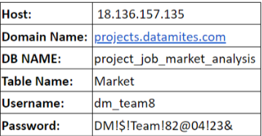
DATABASE CONNECTIVITY AND DATA EXTRACTION
in the market
Securely connect to the database using provided credentials to extract relevant job market data for analysis and visualization.
Database Credentials:

Slide 5
SQL-DRIVEN JOB MARKET ANALYSIS
in the market
States Leading in Job Opportunities
Salary insights by state
Average salary by state
Data science jobs : top 5 industries
Top companies for job openings
Salary for top job titles
Most popular job titles
Skillset by job title
Impact education on average salary

Slide 6
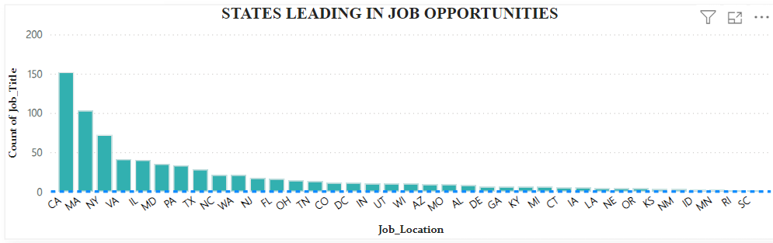
STATES LEADING IN JOB OPPORTUNITIES
in the market
Introduction:
This slide highlights the states with the highest number of job openings, showcasing where the job market is most active.
Key Observations:
The bar chart indicates a significant concentration of job opportunities in certain states.
States like California, Sanfransco , and New York, Cambridge lead in job openings.
Insights:
The concentration of job openings in these states suggests strong economic activity and potential hubs for job seekers.
Companies may prefer these states due to their large workforce and economic stability.

Slide 7
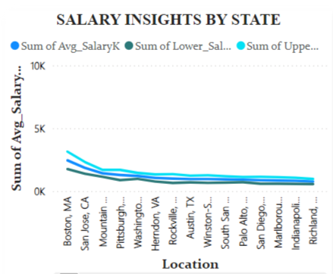

SALARY INSIGHTS BY STATE
in The Market
Introduction:
This slide provides an analysis of the average, minimal, and maximal salaries across various states.
Key Observations:
The line chart displays significant salary disparities between states.
States like California and New York show higher salary ranges compared to others.
Insights:
Higher salary ranges in certain states may correlate with higher living costs and competitive job markets.
Job seekers can use this information to target states that offer better financial incentives.

Slide 8
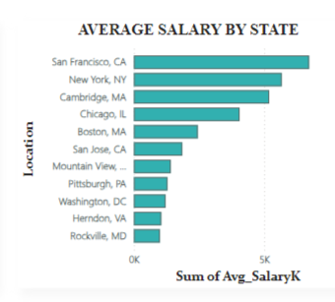

AVERAGE SALARY BY STATE
in The Market
Introduction:
This slide focuses on the average salaries offered in different states.
Key Observations:
The bar chart indicates states with the highest average salaries.
States like San Francisco and New York, Cambridge and Chicago offer higher average salaries.
insights:
States with higher average salaries might attract more skilled professionals.
Companies in these states may offer competitive compensation packages to attract top talent.

Slide 9
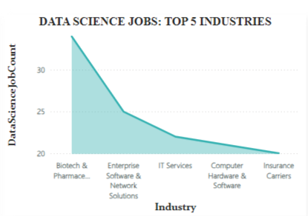

DATA SCIENCE JOBS : TOP 5 INDUSTRIES
in The Market
Introduction:
This slide examines the top 5 industries with the most data science job postings.
Key Observations:
The line chart highlights industries such as Biotech & Pharmaceuticals , Enterprises software & Network Solutions, and IT services leading in data science job postings.
Insights:
The demand for data science professionals is highest in industries that rely heavily on data-driven decision making.
Job seekers with data science skills should focus on these industries for better job opportunities.

Slide 10
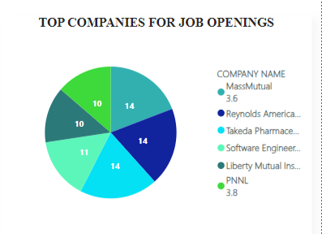

TOP COMPANIES FOR JOB OPENINGS
In The Market
Introduction:
This slide identifies the companies with the highest number of job openings.
Key Observations:
The pie chart shows companies like takeda Pharmaceuticals, MassMutual and Reynolds American leading in job openings.
Insights:
These companies are likely expanding and investing in new talent.
Job seekers can target these companies for potential employment opportunities.

Slide 11
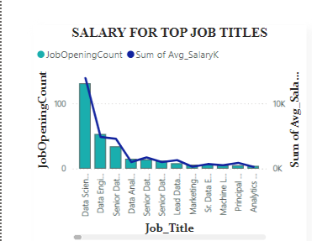

SALARY FOR TOP JOB TITLES
in the Market
Introduction:
This slide showcases the job titles with the most job openings.
Key Observations:
The bar chart reveals job titles such as Data Scientist and Software Engineer have the highest demand.
Insights:
These roles are critical in today’s tech-driven job market.
Job seekers with relevant skills should consider these high-demand job titles.

Slide 12
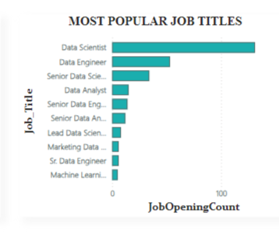

MOST POPULAR JOB TITLES
in the Market
Introduction:
This slide analyzes the average salary for the job titles with the most job openings.
Key Observations:
The bar and line chart combo indicates that job titles like Data Scientist and Software Engineer offer competitive salaries.
Insights:
High-demand job titles also tend to offer higher salaries, reflecting their importance in the market.
Job seekers should align their career paths with these high-paying roles for better financial prospects

Slide 13
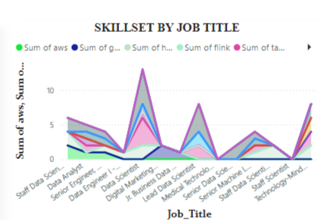

SKILLSET BY JOB TITLE
in the Market
Introduction:
This slide details the skills required by companies for each job title.
Key Observations:
The multi-line chart highlights skills such as Python, SQL, power BI , Tableau and machine learning as highly sought after.
Insights:
Job seekers should focus on acquiring these key skills to enhance their employability.
Companies value these skills for their relevance in data-driven and tech-centric roles.

Slide 14
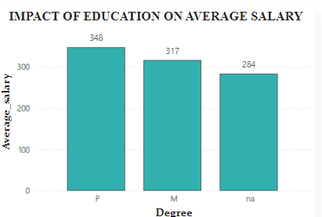

IMPACT EDUCATION ON AVERAGE SALARY
in the Market
Introduction:
This slide explores the relationship between average salary and education levels.
Key Observations:
The bar chart shows that higher education levels generally correspond to higher average salaries.
Degrees such as Ph.D. and Master's are associated with better salary prospects.
Insights:
Investing in higher education can significantly improve earning potential.
Job seekers should consider advanced degrees to enhance their career growth and salary prospects.

Slide 15


CONCLUSION
Introduction:
This slide summarizes the key findings from the job market analysis.
Key Observations:
Significant variations in job opportunities, salaries, and required skills across different states and industries.
High demand for specific job titles and skill sets.
Insights:
Job seekers should tailor their job search strategies based on geographic and industry-specific trends.
Continuous skill development and education are crucial for career advancement and better salary prospects.

Slide 16
Thank
YOU

